Slide 1
Psychology, Technology & Society
2017-2018 I Sem
The LNM Institute of Information Technology

Slide 2
Overview
One of the objectives of the course is for students to understand basic psychological concept and how such concepts could be to understand different aspects of human behavior. In addition, it also aim to address the complex relationship between human psychology, technology and society. The course encourages students to use critical thinking to evaluate human behavior and related aspects using a scientific approach.

Slide 3
Course Outcomes
On completion of this course,
CO1 Students will develop an objective understanding of the field of psychology and basic human cognitive processes and their applications.
CO2: Students will be able to understand the concept and processes of social cognition and social influence.
CO3: Students will be able to understand the complex relationship between technology, health and well-being.
CO4: Students will be able to understand social aspects of technology and vice versa.

Slide 4
Course Topics
UNIT - I Human Cognition: Introduction, Basic cognitive processes of Learning, Memory, Perception, Motivation, Emotion, Problem Solving, Decision Making and their Application in different domains of Life.
UNIT – II Social Cognition and Social Influence: Cognitive processes underlying human thought and its impact on human interaction. Role of Schemas, Prototypes and Heuristics in understanding the society and social information. Potential sources of error in Social Cognition. Basic principles and applications of societal influence. Group Dynamics and Teamwork. Power, Politics and Leadership.

Slide 5
UNIT – III Technology, Health and Wellbeing: Technology and health: Pros and cons, Technology and wellbeing: Adjustment, Stress, Coping with Stress.
UNIT – IV Technology and Society: Technology and Human evolution; The social shaping of technology. Technology and society in information age, Technology and Self presentation, Technology and social relationship, Technology and Social Justice, Technology and Social Problems.

Slide 6
Text Book:
Smith, E.E., Nolen-Hoeksema, S., Fredrickson, B., Loftus, G.R. (2003): Atkinson and Hilgard’s Introduction to Psychology (14th ed.). India: Wadsworth Publishing (Available in the Library)
Rosen, L.D., Cheever, N.A. & Carrier, M. (2015). The Wiley Handbook of Psychology, Technology and Society. John Willy & Sons
Robbins, S.P. (2003): Organizational Behaviour (10th ed.)
Reference Books:
D. G. Johnson and J.M. Wetmore (2009). Technology and Society: Building Our Socioethical Future. MIT Press, 2009.
Hamburger, Y.A. (2009). Technology and Psychological Well-being. Cambridge University Press
Morgan, C.T., King, R.A., Weisz, J.R., & Schopler, J. (2004). Introduction to Psychology. New York: McGraw Hill Book Co.
Relevant research articles.

Slide 7
Evaluation Methods:
Compulsory Class Attendance: 60%
Item | Weightage
Midterm | 30 %
Final Examination | 45 %
Term Paper & Presentation | 15%
Quizzes | 10%
Attendance | 5% (Bonus)

Slide 8
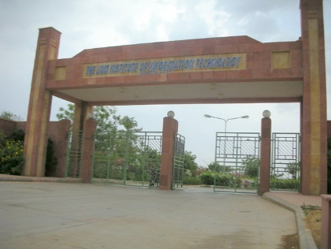



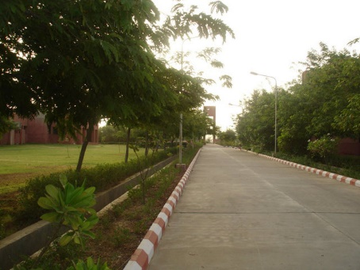

Thank you, for your time and attention!
The LNMIIT: Where young dreams take shape …..

